Slide 1

“Celebreno”: A Web-based Application for Event Planning using ASP.net
Caledonian College of Engineering
Department of Electrical & Communication Engineering
Web Programming ( MHH624653 )
Maha Mahmoud 150792
Supervisor:
Mr. Ramakrishna Kumar

Slide 2
Agenda Layout
1
Introduction
2
Requirements Gathering
3
Design
4
Implementation Details
5
Result and Discussion
6
Conclusion and Future Work

Slide 3

Aim
Objectives
To develop a web application
for event planning using ASP.net
wherein there are many services provided by different event
planners.
To study and review the current
event planning web applications.
To study the development of web
applications critically.
To design the concept and structure of the event planning web application.
To develop the event planning web
application using asp.net with C#.
To provide the functionality of online event planning.
To test and implement the event
planning web application.

Slide 4

1. Introduction
Problem Description.
Project Significance.
Project benefits.

Slide 5
2. Requirements Engineering
Business Level Requirements.
User Level Requirements.
Functional Requirements
Non-Functional Requirements
Product Level Requirements.

Slide 6
3.1 Database (UML Class) Diagram
3. Design

Slide 7
3.2 Flowchart of buying a service package by a customer

Slide 8
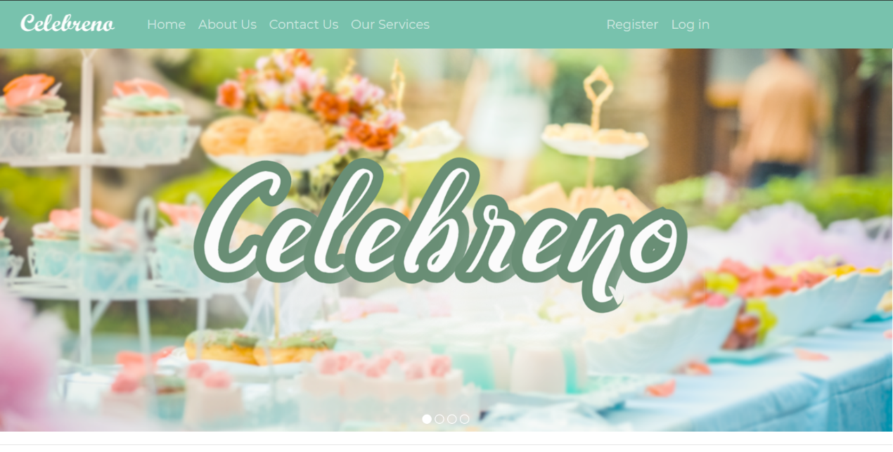
3.3 User Interface

Slide 11
4. Implementation Details
ASP.NET Web Forms Template.
ASP.NET Identity (Membership)
Adding User Roles and limit access
Entity Framework Code First
SQL Server Express Local DB
Master Pages
Bootstrap (Modifying the UI)
NuGet Packages
Unobtrusive Validation
Using Query String and Cookies
Error Handling and ELMAH
URL Routing

Slide 12
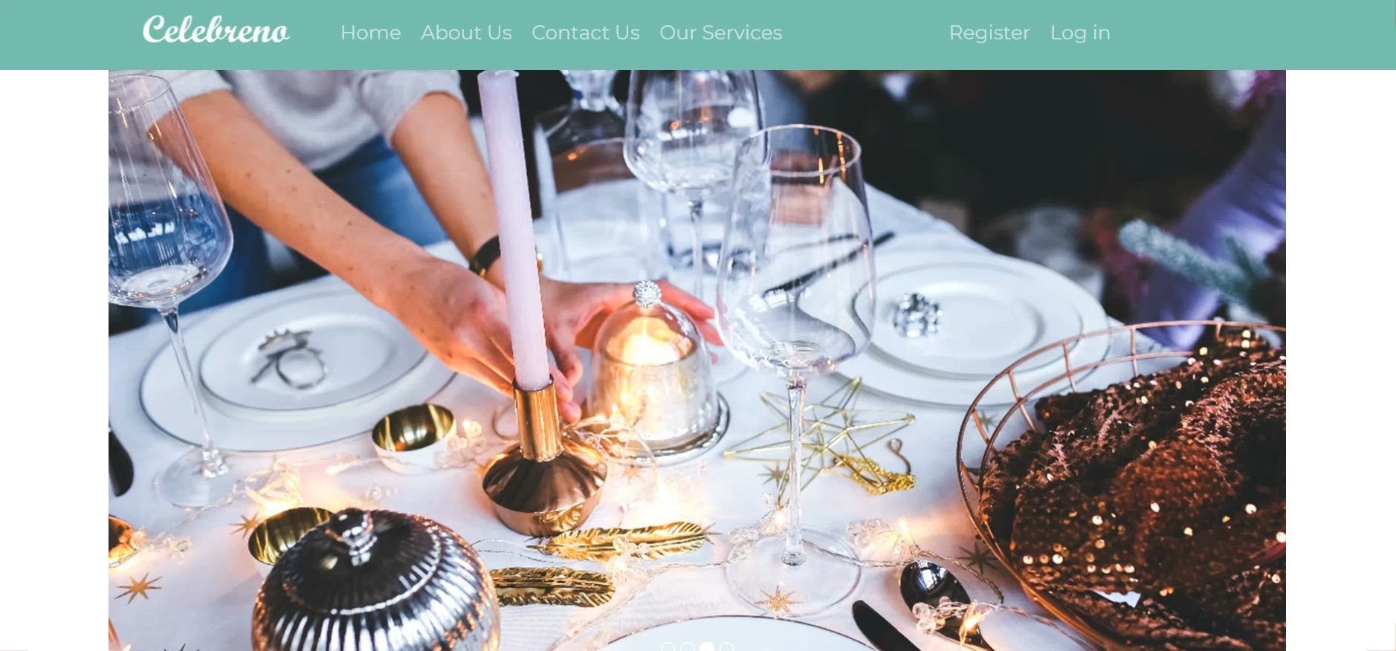
5. Results and Discussion
* Please Play the video below

Slide 13
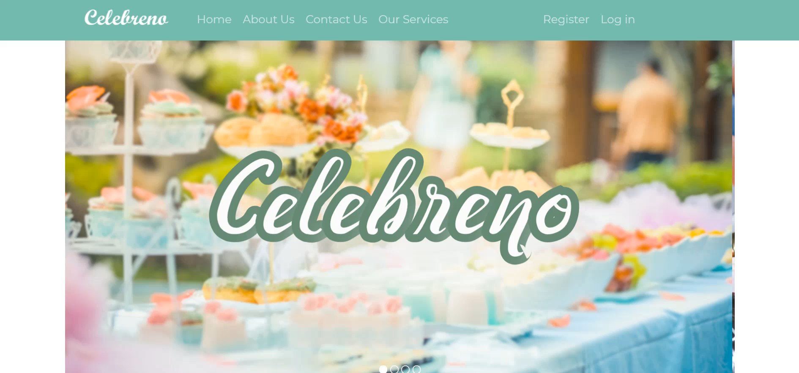
* Please Play the video below

Slide 14
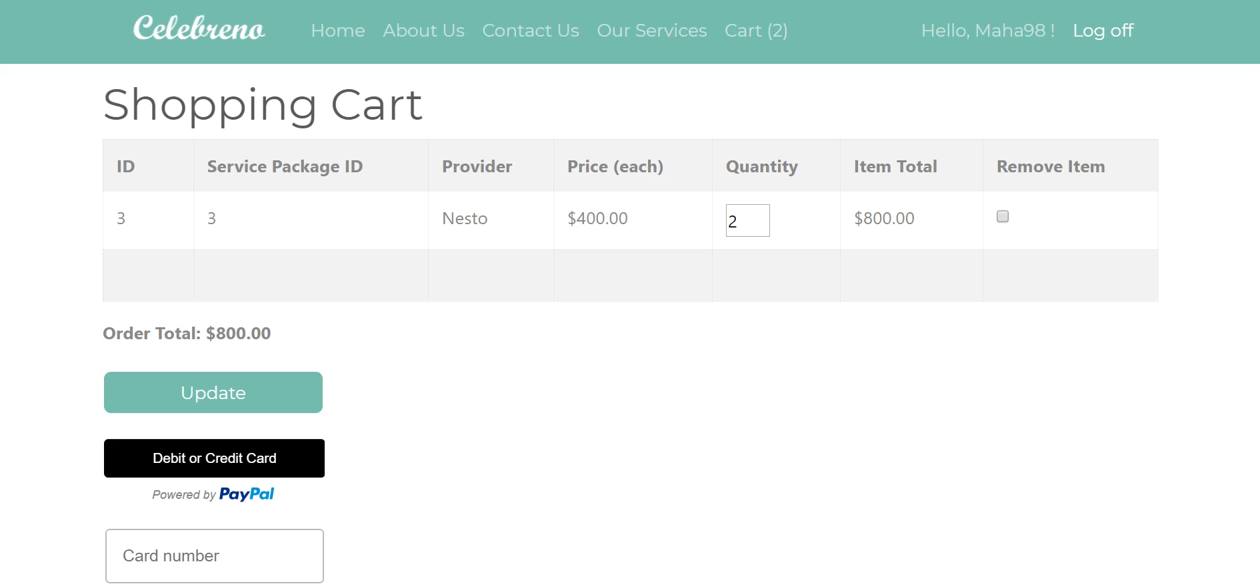
* Please Play the video below

Slide 15
Conclusion
In conclusion, Celebreno web application
will be a great option for people who need to plan their events. It is free to use and
user-friendly. The requirements analysis,
design, implementation details, results and
discussion are clearly mentioned.

Slide 16
Future Work
Host the Web Application
Incorporate a Chatbot into the web application
Setting up Two Factor Authentication.
Adding a search functionality.

Slide 17
References
AjayKumar, Taher & Kasture, 2018. A study and implementation of event management system using smartphone. In Journal of Emerging Technologies and Innovative Research 2018. Ahmadabad, April 2018. Ahmadabad: AjayKumar. pp. 1-4.
Binti & Ghani, 2016. A generic web-based event management system (GEMS). In UTM Computing Proceedings. Kula Lumpur, September 2016. Kula Lumpur: Binti. pp. 1-6.
Gleb, B., 2019. How Do Free Mobile Apps Make Money?. [Online] Available at: https://rubygarage.org/blog/how-do-free-apps-make-money [Accessed 19 December 2019].
Kryzhanovska , A., 2019. How to Make a Free Web App Earn You Money. [Online] Available at: https://gearheart.io/blog/how-make-free-web-app-earn-you-money/ [Accessed December 19 2019].
WorkFront, 2018. The 6 project constraints and how to manage them. [Online] Available at: https://www.workfront.com/blog/the-6-project-constraints [Accessed 19 December 2019].

Slide 18
Thank you for your attention

